Slide 1
Subject : COMP6360004 - ALGORITHM AND PROGRAMMING
Program Control:
Repetition

Slide 2
Learning Outcomes
At the end of this session, student will be able to:
LO2 : Apply syntax and functions in C language in problem solving
LO3 : Construct a program using C language in problem solving

Slide 3
Sub Topics
For
While
Do-While
Break vs Continue
Create simple program using repetition

Slide 4
Repetition
One or more instruction repeated for certain amount of time
Number of repetition can be predefined (hard-coded in program) or defined later at run time
Repetition/looping operation:
for
while
do-while

Slide 5
Repetition: for statement
Syntax : for (expression1; expression2; expression3) statement; or for (expression1; expression2; expression3) { statement1; statement2; …… }
Flow Chart of FOR Statement
exp1
exp3
statements
expression1 : initialization
expression2 : conditional
expression3 : increment or decrement
expression1, expression2 and expression3 are optional
expression1 and expression3 can consist of several expression separated with comma
exp2
true
false

Slide 6
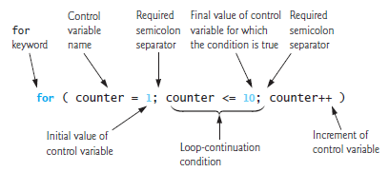
Repetition: for statement
For example, print the value 1 to 10
Syntax :
#include<stdio.h>
int main()
{
int counter;
for( counter = 1 ; counter <= 10 ; counter++ ) { printf( "%d\n", counter );
}
return(0);
}
Output:
1
2
3
4
5
6
7
8
9
10
Other Syntax :
#include<stdio.h>
int main()
{
int x;
for( x = 10 ; x >= 1 ; x-- ) printf( "%d\n", x);
return(0);
}

Slide 7
Repetition: nested for statement
Loop in a loop. The repetition operation will start from the inner side loop.
Syntax :
int x, y;
for (x=1;x<=3;x++)
for (y=5; y>=1; y--)
printf(”%d %d ”,x,y);
Output :
1 5 1 4 1 3 1 2 1 1 2 5 2 4 2 3 2 2 2 1 3 5 3 4 3 3 3 2 3 1

Slide 8
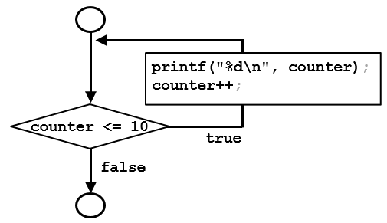
Repetition: while statement
Syntax :
while (expression) statements; or while (expression) { statement1; statement2; …… }
Flow Chart of WHILE Statement
statements
condition
true
false
expression is Boolean expression. It will result in true (not zero) or false (equal to zero).
Statement will be executed while the expression is not equal to zero.
expression evaluation is done before the statements executed.
For example, print the value 1 to 10.
Syntax:
Output:
#include<stdio.h>
int main()
{
int counter = 1;
while ( counter <= 10 ) {
printf( "%d\n", counter );
counter++;
}
}
1
2
3
4
5
6
7
8
9
10

Slide 9
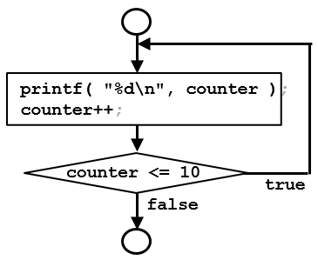
Repetition: do-while statement
Syntax :
do {
< statements >;
} while (expression);
Flow Chart of DO-WHILE Statement
statements
condition
true
false
Keep executing while expression is true.
Expression evaluation done after executing the statement(s)
For example, print the value 1 to 10.
Syntax:
Output:
#include<stdio.h>
int main()
{
int counter=0;
do {
printf( "%d\n", counter );
counter++;
} while (counter <= 10);
}
1
2
3
4
5
6
7
8
9
10

Slide 10
Break vs Continue
Example using break
Example using continue
#include <stdio.h>
int main()
{
int x;
for(x=1; x<=10; x++) {
if (x == 5) break;
printf("%d ", x);
}
return 0;
}
#include <stdio.h>
int main()
{
int x;
for(x=1; x<=10; x++) {
if (x == 5) continue;
printf("%d ", x);
}
return 0;
}
end the loop
Output : 1 2 3 4
Output : 1 2 3 4 6 7 8 9 10
- break is to force finish the loop
- ending loop (for, while and do-while)
- end the switch operation
skip all the rest of statements (subsequent to the skip statement) inside a repetition, and continue normally to the next loop

Slide 11
Create simple program using repetition
Create a C program to print odd number between 1 to 20, using
for
while
do-while
Create a C program to print
*
* *
* * *
* * * *
* * * * *

Slide 12
Reference
Paul Deitel & Harvey Deitel. (2016). C how to program: with an introduction to C++. 08. Pearson Education. Hoboken. ISBN: 9780133976892.

Slide 13
THANK YOU

